Slide 1
MDF planning and processes Tool DK, FI, NO, SE, IS
Claus Borvang
Nordic Partner Marketing Manager
Brief 11/3 - 2015

Slide 2
MDF planning and processes
Processes, roles & responsibilities around local MDF planning, execution and tracking
Agenda:
Funding sources for partner activities + MDF basics
Partner acitivity plan, - planning process
PreApproval
Claim
POE
Approval
Task:
Make an online webbased planning and tracking tool
Back up:
Roles and Responsibilites Partner vs Dell
Scope: Denmark, Norway, Finland, Sweden and Island 6 dist and 450 partners –total 1500

Slide 3
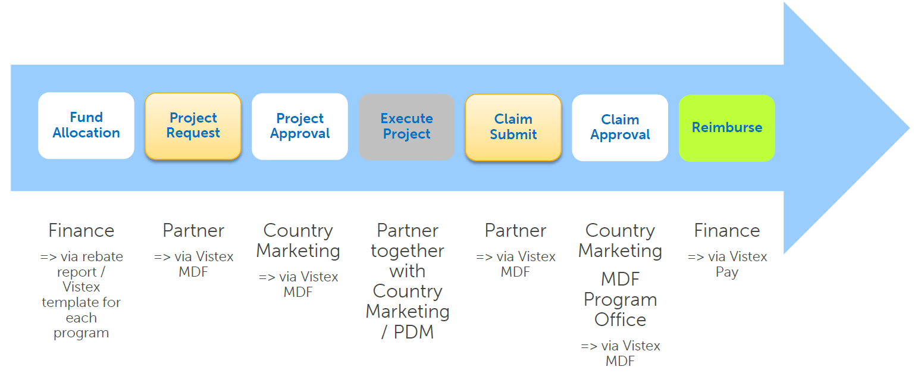
MDF management moving forward…
Vistex channelconduit – New global tool for managing MDF
- Coming FY16Q2
- The web based tool will help us to automate the MDF process
- It will replace PMAM, MDF Online Tool and manual payment process
- All stakeholders work on the same tool = far less emails and syncing.
- One global tool and it’s database helps to standardize the process
- Analysis of data will follow global standards and will help decision making process

Slide 4
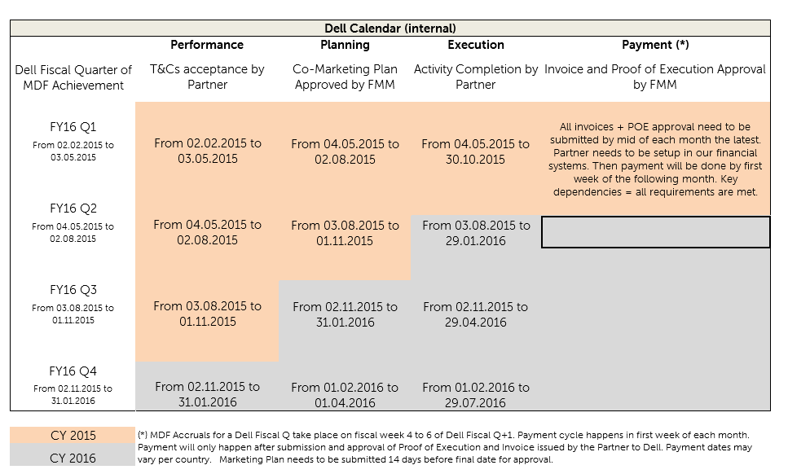

Slide 5
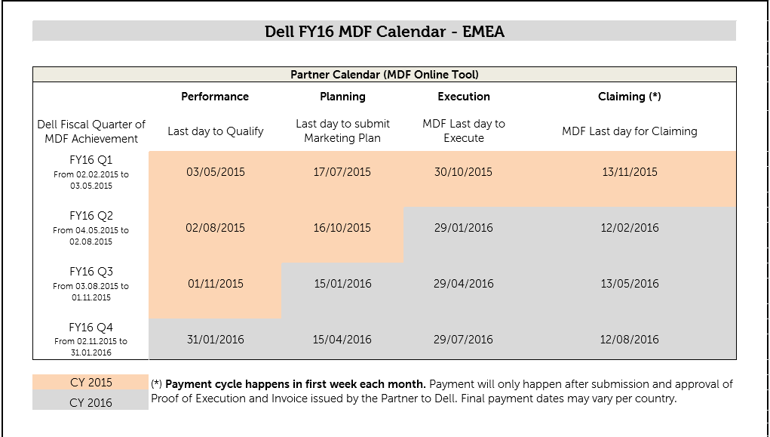

Slide 6
Planning with Partner
- Plans are updated and progress tracked on bi-weekly 1:1s between PDMs and Channel MM
- Execution is owned by the PDM, supported by local marketing and the Channel MM.
- Post execution phase is owned by the PDM (follow up, submission of POE).
- Channel MM finally approves POE and MDF invoices upon execution of activities.
Roles & Responsibilites between PDMs and Marketing in terms of planninng, exection and post-mortem in back-up

Slide 7
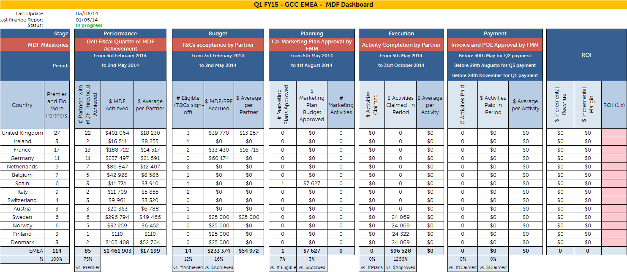
Dashboard report request

Slide 8
Click through report
Campaign | Activity | Date | Reciptients | Uniq opens/Hits | Uniq clicks
Generel | Front spot | December | Average no. of logins per day = 2100 | Not available | Not available
Generel | Front spot | January | Average no. of logins per day = 2100 | Not available | Not available
Generel | TDUpdate | 06-nov | 4175 | 1041 | 56
Generel | TDUpdate | 18-nov | 4162 | 1130 | 133
Generel | TDUpdate | 20-nov | 4162 | 1071 | 99
Generel | TDUpdate | 27-nov | 4150 | 1197 | 66
Generel | TDUpdate | 04-dec | 4140 | 1126 | 133
Generel | TDUpdate | 11-dec | 4115 | 1089 | 69
Generel | TDUpdate | 16-dec | 4112 | 970 | 64
Generel | TDUpdate | 18-dec | 4109 | 1046 | 53
Generel | TDUpdate | 30-dec | 4109 | 1127 | 46
Generel | TDUpdate | 06-jan | 4106 | 1030 | 75
Generel | TDUpdate | 08-jan | 4101 | 602 | 28
Special | Monthly campaign | 03-nov | 4190 | 1065 | 14
Special | Black Friday | 28-nov | 4150 | 1312 | 203
Special | Vi sender en drone | 02-dec | 4149 | 1374 | 55
Special | Christmas calender | 05-dec | 293 | 293 | 124
Special | Monthly campaign | 08-jan | 4101 | 602 | 28
Special | TechXtra Days | 21.-23. Jan | 4100 | Not yet available | Not yet available
 |  |  |  |  |  | Sell out campaign products DKK not yet available
Nordic | Spiff mail | 08-jan | 4102 | 897 | 57 | Sell out total products DKK not yet available
Nordic | TDUpdate | 08-jan | 4101 | 602 | 28
Nordic | Wall paper public | 1 week |  | 6328 | 56
Nordic | Wall paper non public | 1 week |  | 10248 | 42
Nordic | Front spot | 3 weeks | Average no. of logins per day = 2100 | Not available | Not available

Slide 9
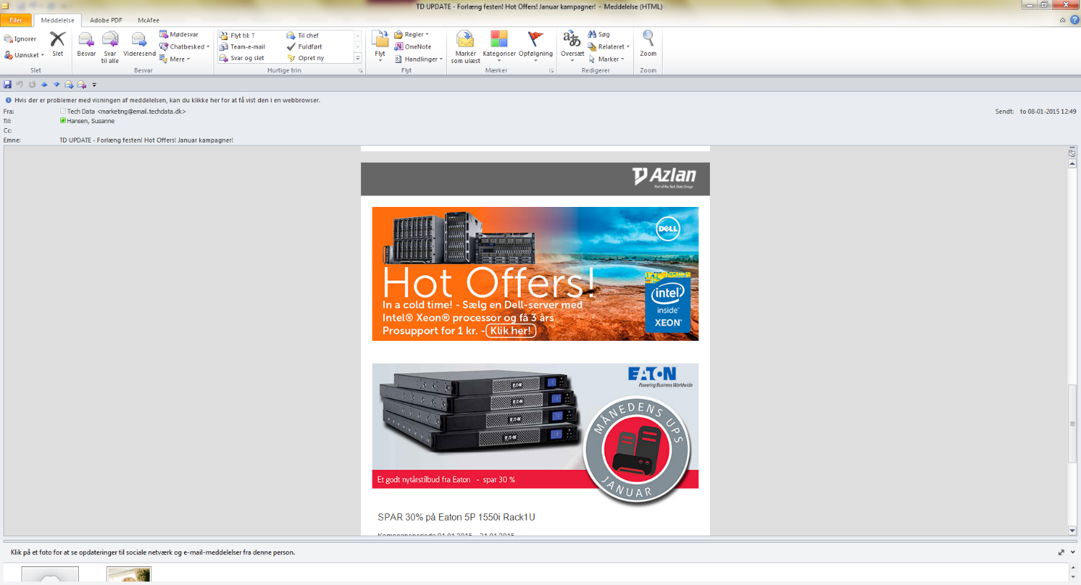
TDUpdate 8/1 Awareness

Slide 10
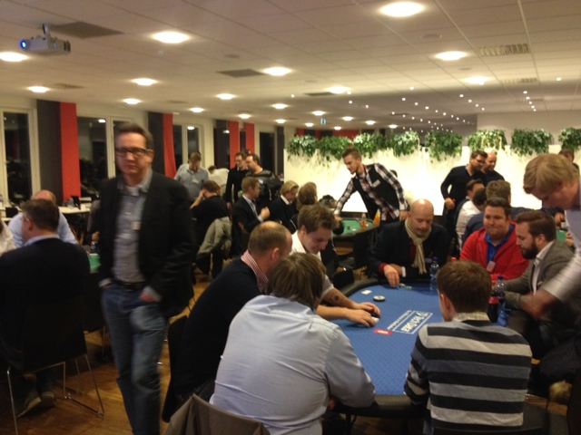
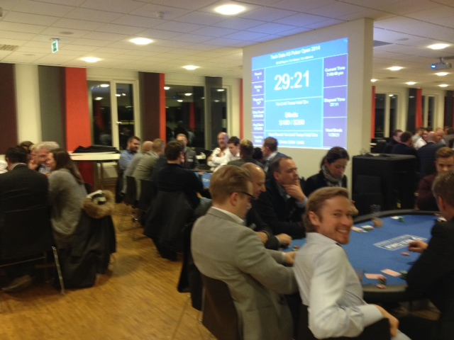
Product Evening

Slide 11
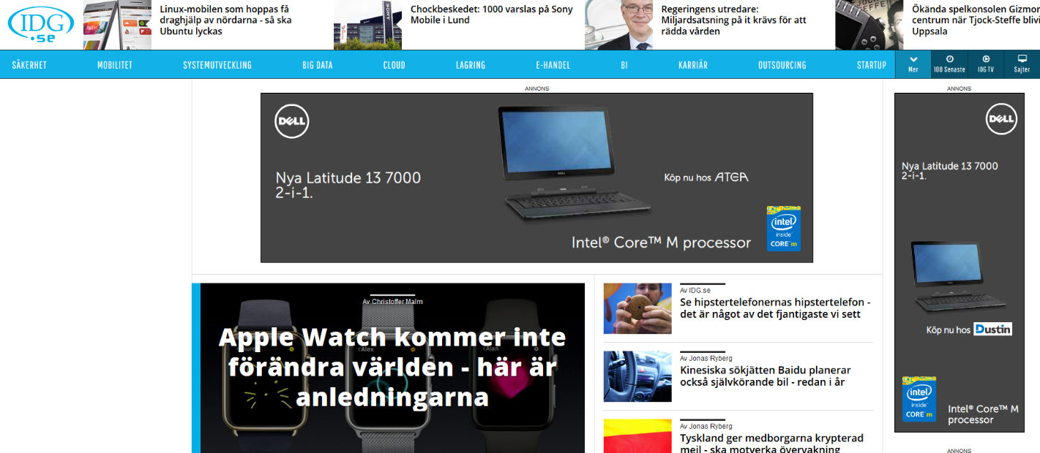
Online sample

Slide 12

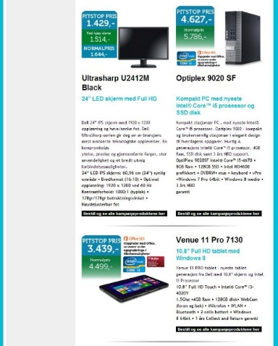


Key Activities & Initiatives
Planned Partner and DMR Activities, Events & Initiatives
Nordic
s
Repeat AMD Q4 Campaign – Workstation up 105 K USD for NDC
Vostro re-egnite Acguisition and reactivation – 125 Resellers and 1800 units
ESG Reseller Acquisition VTRX print Campaign – Xbox Dell and MS ROK Boost
NDC Campaign W10-12 – Broad line up, assets, offline activities, incentive trip – target sales out $ 4 M
NDC Dell/Techdata Workshop 1) Alling 13 week planing cycle R&R 2) How to take salesout to 200% in FY16
Notes:
Optional slide:
Current Events, Activities and initiatives

Slide 13
Back up

Slide 14
Q2FY13 Intel Initiatives POE collection
Digital Media Ads – DUSTIN

Slide 15
POE: 3rd party invoice with line item detail - need to be as embedded file – good readable.

Slide 16



POE: Creative & screen shot of ad destination page (ADP) - need to be as embedded file – good readable. www.DUSTIN.dk and www.dustin.se

Slide 17
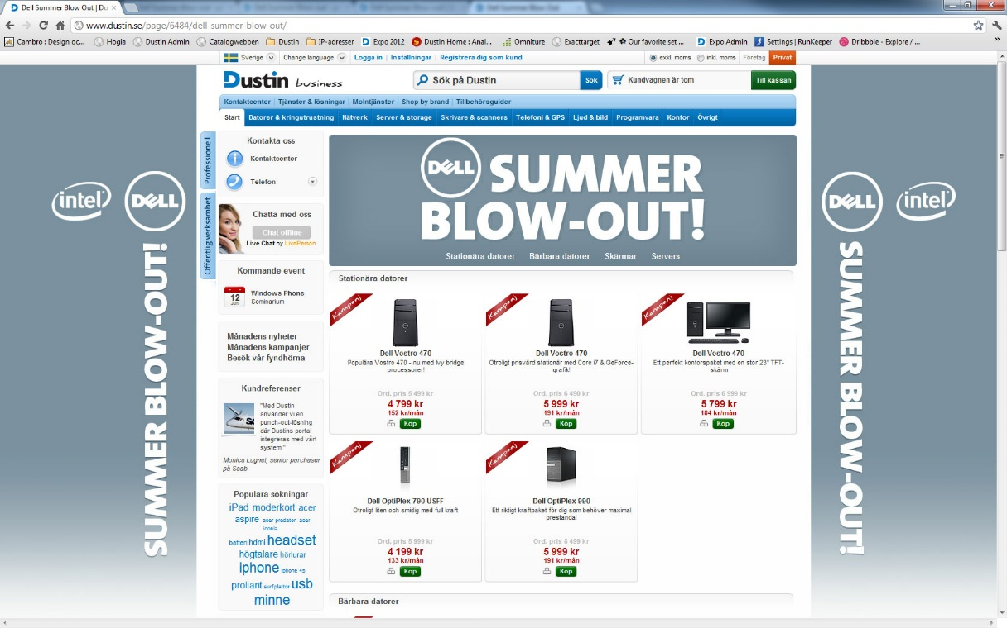
POE: Creative & screen shot of ad destination page (ADP) - need to be as embedded file – good readable. www.DUSTIN.dk and www.DUSTIN.se

Slide 18


POE: Creative & screen shot of ad destination page (ADP) - need to be as embedded file – good readable. www.DUSTIN.dk and www.DUSTIN.se

Slide 19
POE: Independent tracking report with pertinent information (e.g. run dates, # of clicks and/or impressions) - need to be as embedded file – good readable. N/A

Slide 20
Please save as filename QxFYy – county - partner name – activity type and send only when complete !!! Example: Q1FY13 – France – Cash & Carry – digital media ads.ppt Deadline for $ claim (and POE when complete): Dell ww11.1 Deadline for complete POE: 30 days after – otherwise you may loose the Intel $.

